Slide 1
Design and Control of the BlueFoot Platform:
A Multi-terrain Quadruped Robot
Brian Cairl
Dr. Farshad Khorrami
May 13, 2015

Slide 2
Overview
Introduction
Hardware and Design
Software Architecture
System Modeling
Gait and Stability Control
Navigation Control
Concluding Remarks

Slide 3
Introduction

Slide 4
Quadruped Robotics
Inspired by notable quadruped robotic systems from the past decade:
LittleDog (Boston Dynamics)
BigDog (Boston Dynamics)
Tekken (Kyoto Institute of Technology)
Kolt (Stanford University)
HyQ (Istituto Italiano di Tecnologia)

Slide 5
Quadruped Robotics, cont.
Well known advantages over wheeled robots, mainly in adaptability to terrain
At the follows expenses:
Higher power consumption (more actuators)
Lower payload capacity (higher actuator loading)

Slide 6
Quadruped Robotics, cont.
Applications:
Gaiting design/research
Rough-terrain navigation/planning
Disaster recovery
Search and rescue
Environmental mapping

Slide 7
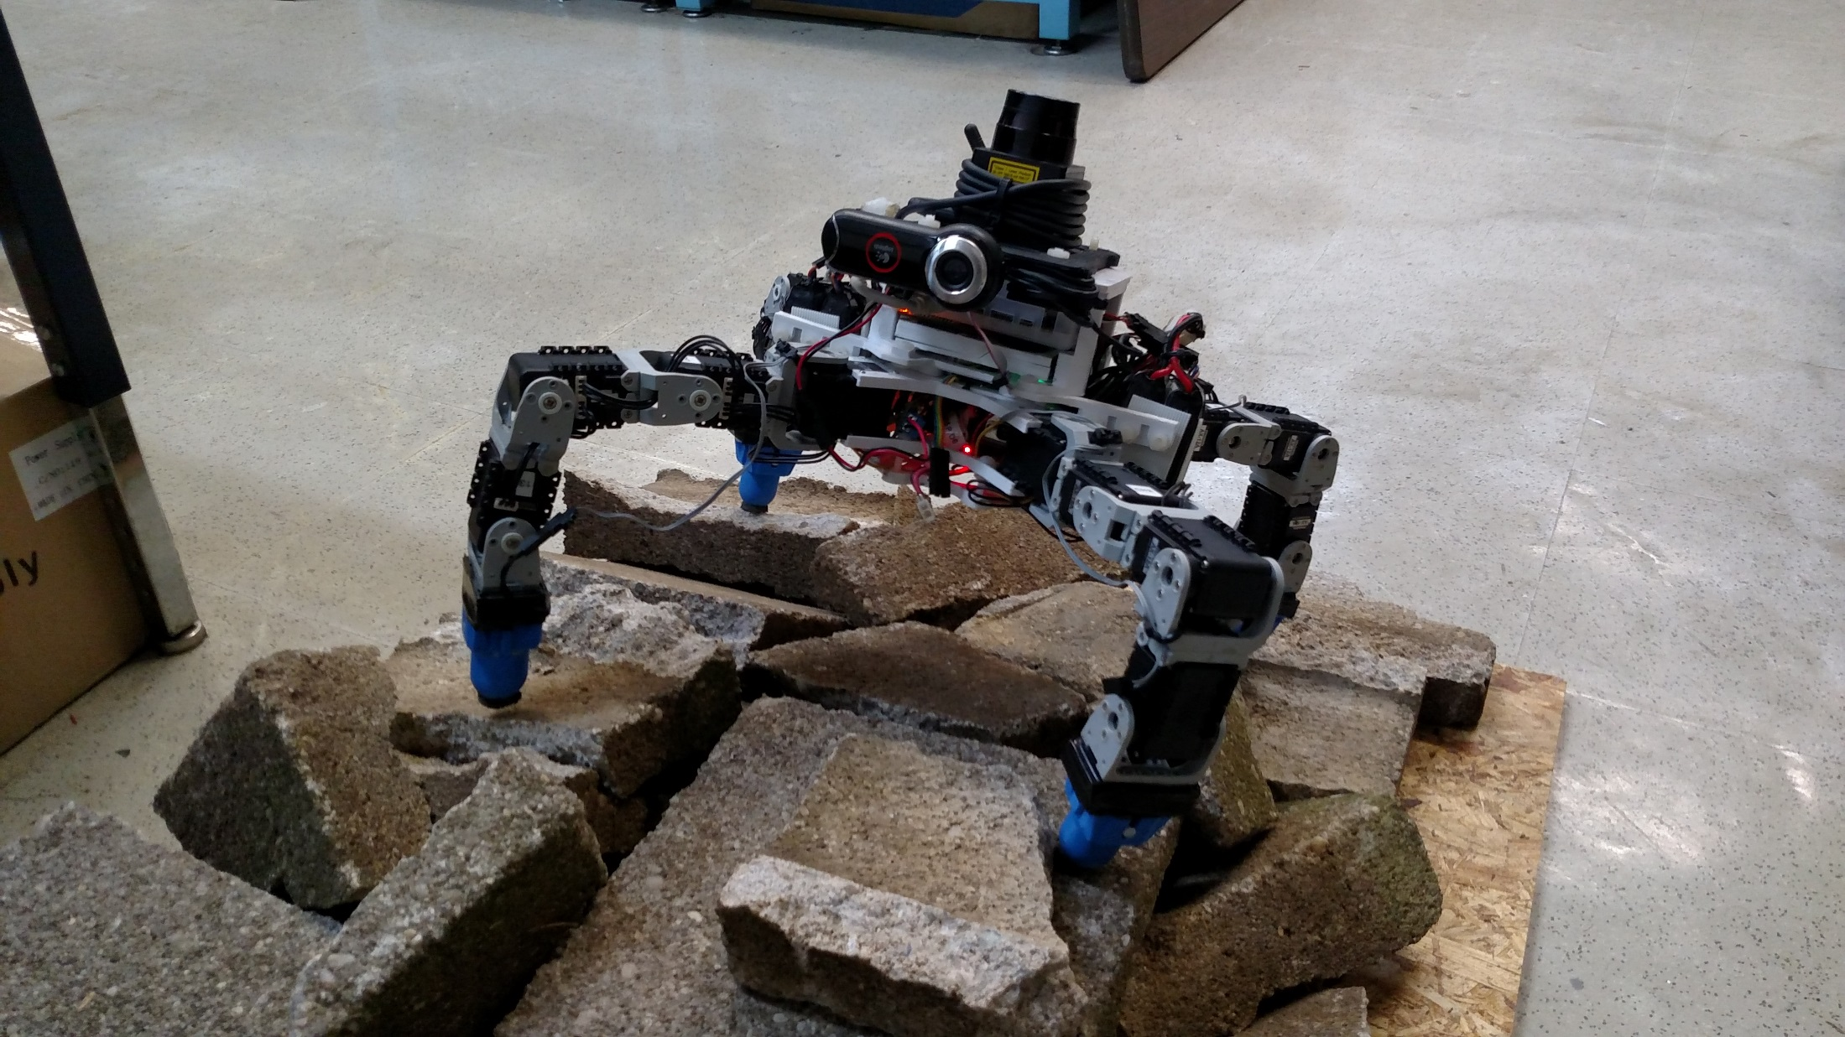
The BlueFoot Platform

Slide 8
The BlueFoot Platform, cont.
Small-scale quadruped robot
16 actuated degrees of freedom
Multi-processor/distributed control implementation
High Dexterity, which lends itself to:
Stabilization and repositioning on variable terrain
Large range of trunk articulation
Ability to overcome raised/uneven terrain

Slide 9
Overview of Control Strategies
Gaiting and Stability
Central Pattern Generator (CPG)-based gait control
Zero-Moment Point (ZMP) body posture control
Virtual-Force foothold controller
NARX-Neural Network trunk-leveling controller

Slide 10
Overview of Control Strategies, cont.
Navigation Control:
Potential-Fields/Visual-Servoing
Surface Reconstruction for rough terrain navigation
Composing 3D point clouds from 2D LIDAR scans
Height-map Surface Representation
Surface (Normal) Estimation from 3D point clouds
Rough terrain planning using Height-maps

Slide 11
System Design

Slide 12
Design Overview
Modularity between body segments
Robot designed with 3 main sections
3D printed structural components
Lightweight
Rapid design iterations
Facilitates modular design

Slide 13
Core Devices
AutoPilot
TM4C MCU (80 MHz) and RM48 MCU (220 MHz)
Inertial Measurement Unit (IMU)
3-axis accelerometer (x2)
3-axis gyroscope
Magnetometer
Pressure/Humidity Sensor

Slide 14
Core Devices, cont.
ODROID-XU computer
1.6 Ghz, quad-core processor
2 Gb of RAM
WiFi Antenna
Logitech9000 Web Camera
30 fps
1280 by 720 max resolution

Slide 15
Core Devices, cont.
Hokuyo-URG LIDAR
0.3822 degree scan resolution (628 points per scan)
5.6 meter range
Dynamixel AX12 Smart Servos (x16)
Position, Velocity, Torque-Loading Feedback
1 Mbps data transfer rate
High-gain proportional controller

Slide 16
Core Devices, cont.
Binary foot-contact sensors
XBEE Wireless Radio
27 meter outdoor range
115 kbps max data transfer rate
57.6 kbps nominal data transfer rate

Slide 17
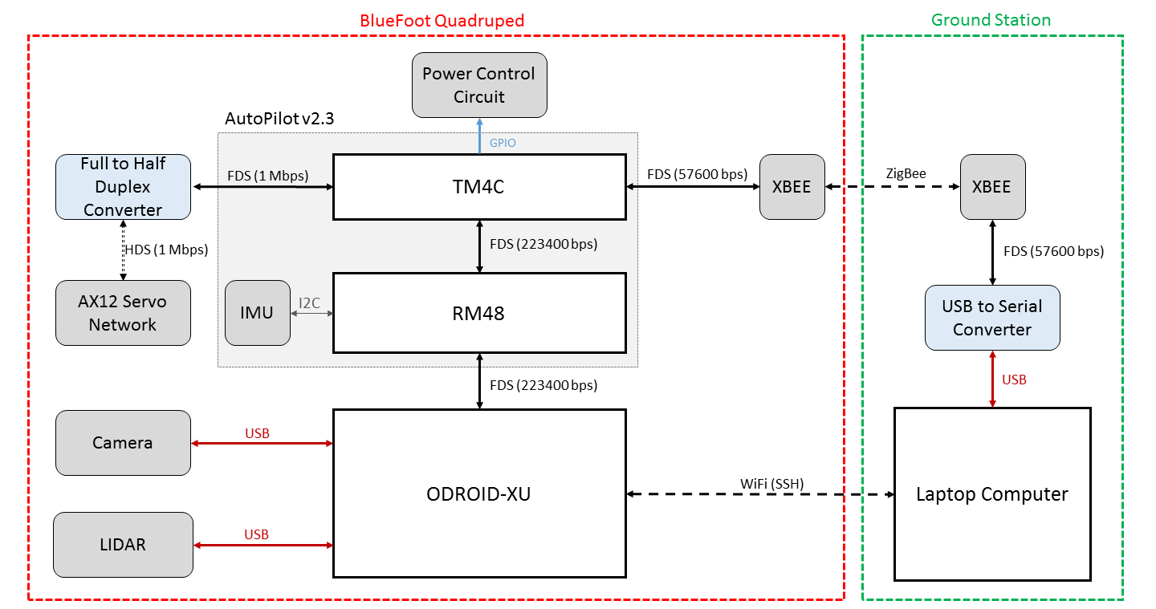
Device Interfacing

Slide 18
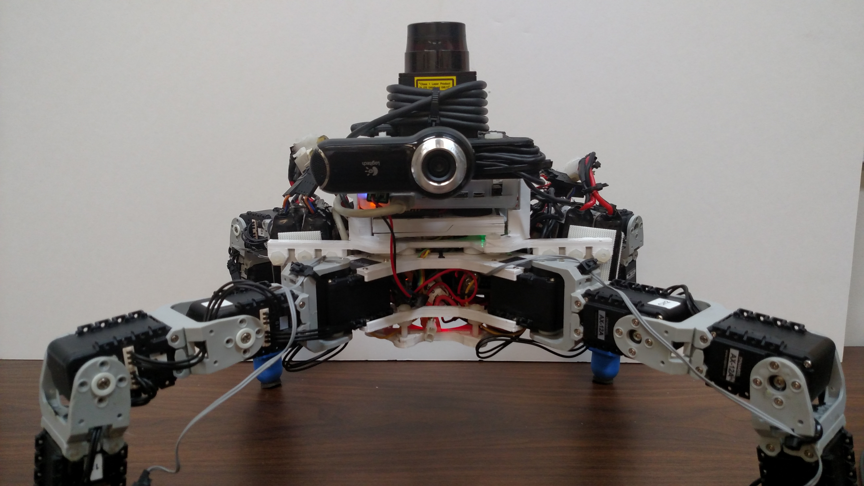
Structural Layout
Head Module
Main Module
Root Module
Legs

Slide 19
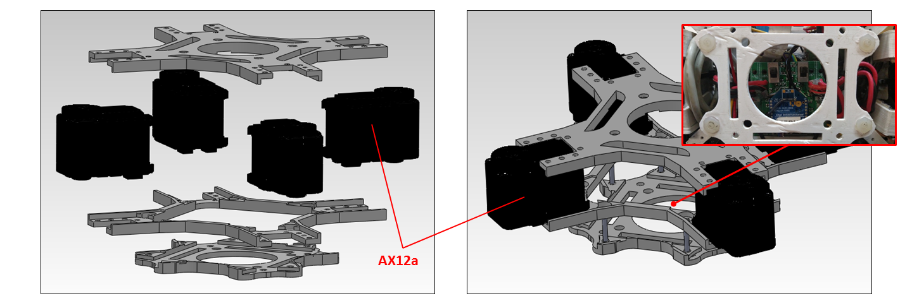
Lower Body (Root Module)

Slide 20
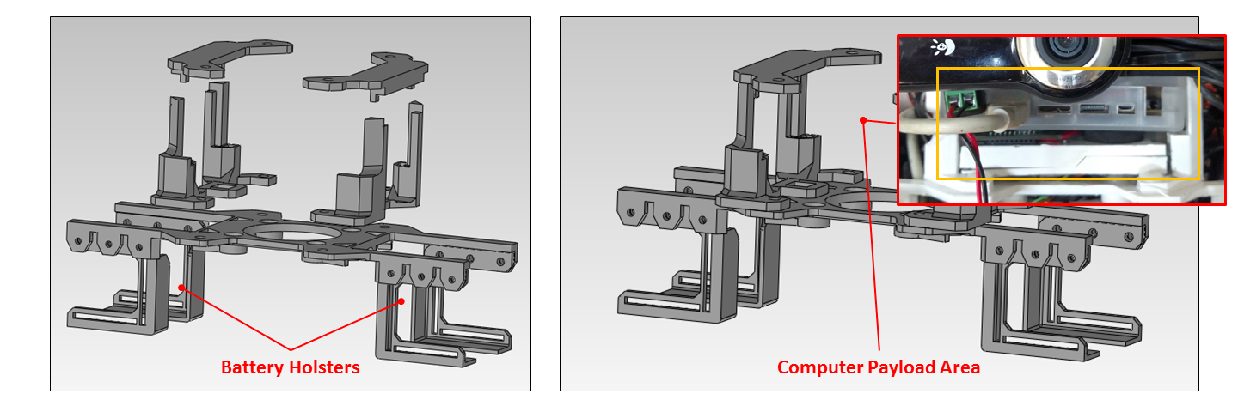
Mid Body (Main Module)

Slide 21
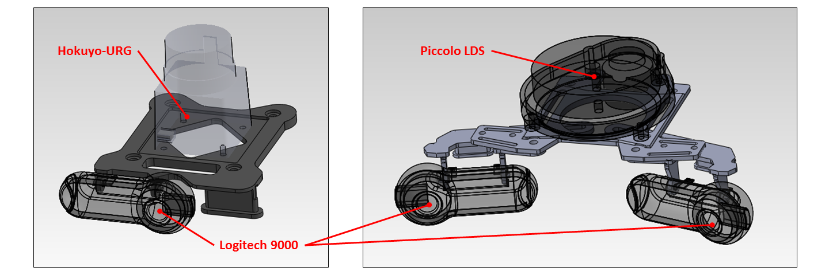
Upper Body (Head Module)

Slide 22
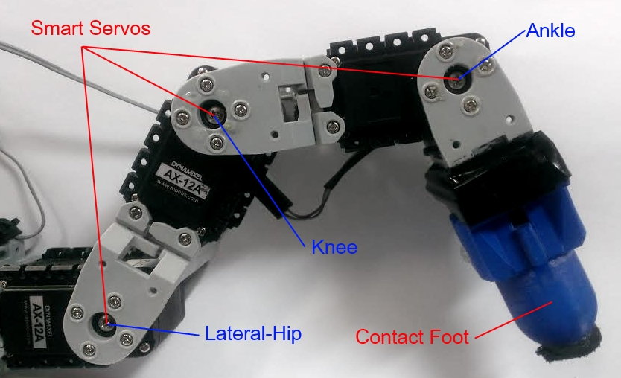
Leg Design

Slide 23
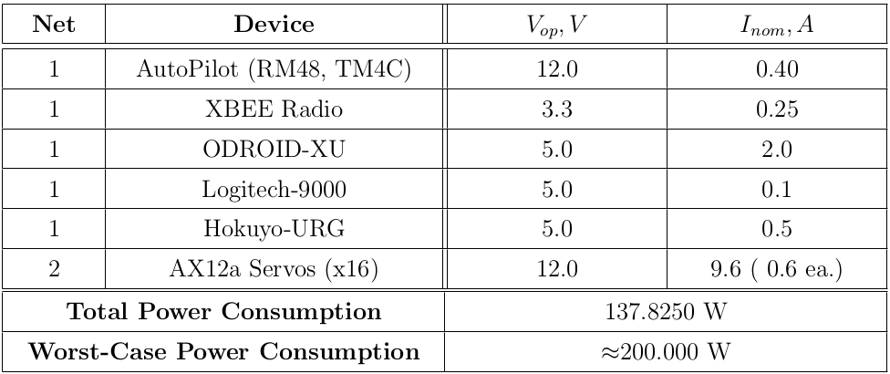
Power Requirements

Slide 24
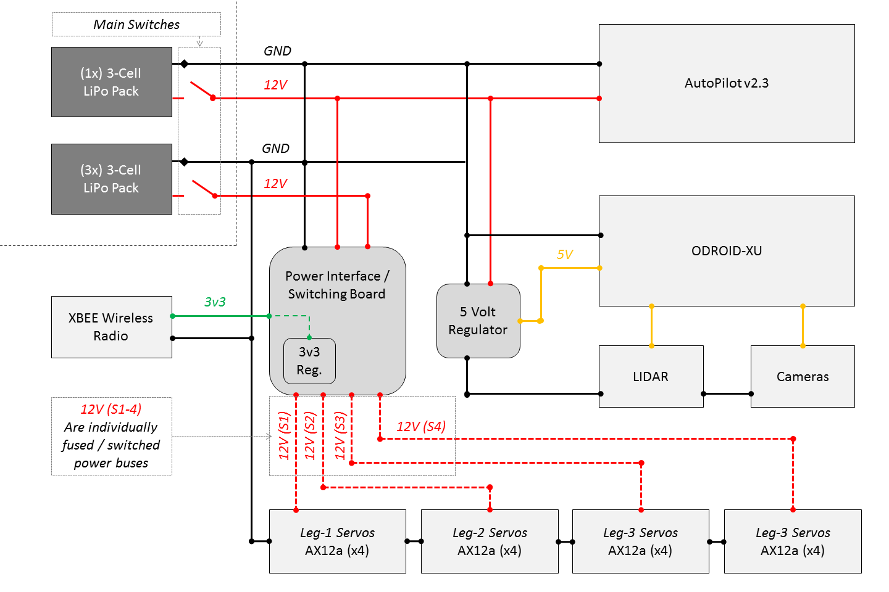

Slide 25
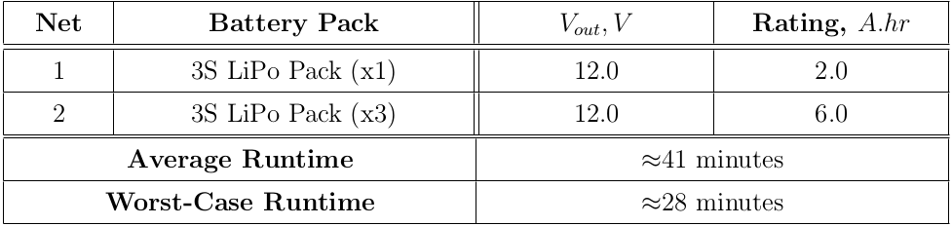
Power Capacity and Run-time

Slide 26
Software: Overview

Slide 27
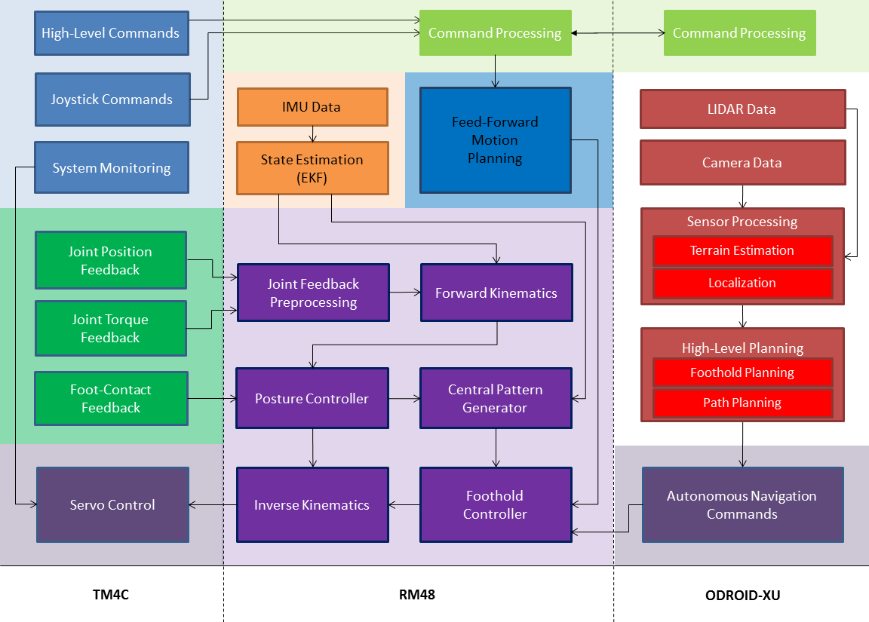

Slide 28
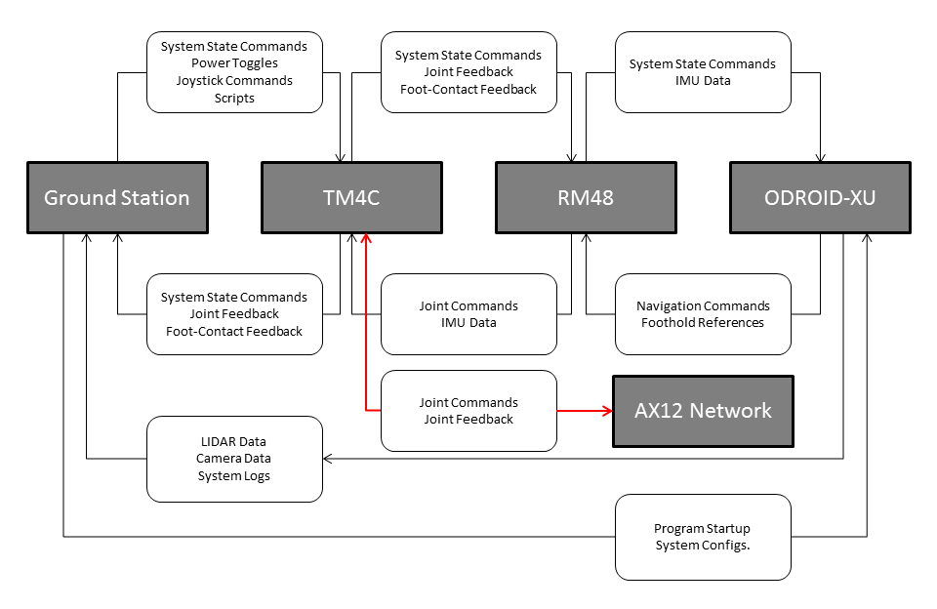

Slide 29
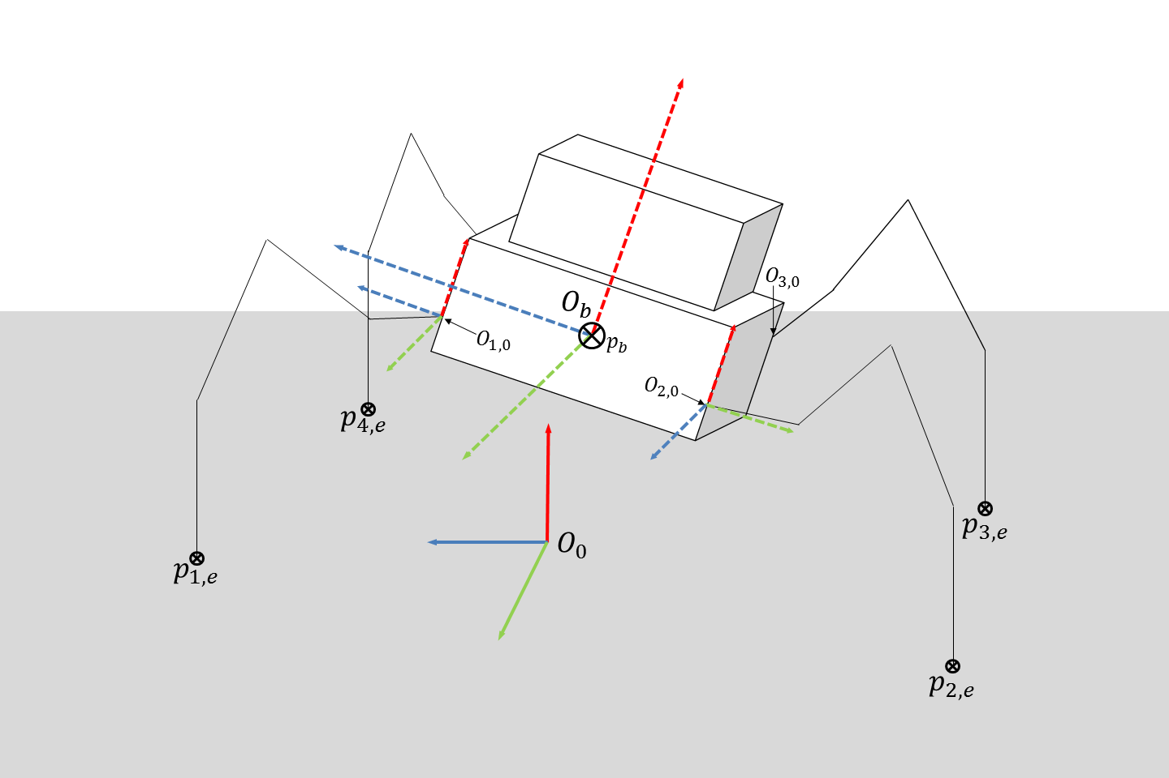
Coordinate Frame setup for Position Kinematics

Slide 30
System Modeling

Slide 31
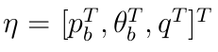
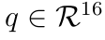
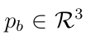
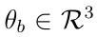
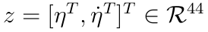
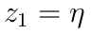
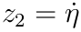
System State Vector
Considering the robot as a free-floating system with 4 legs (each 4DOF):
Joint angles
Trunk Position
Trunk Orientation
Gives rise to the following state vector:

Slide 32
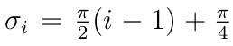
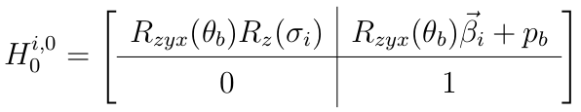
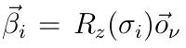
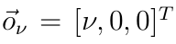
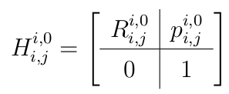

Position Kinematics: Frame Transformations
Position of the first joint of the $i^{th}$ leg in the world frame.
General transformation to each $j^{th}$ joint from the 1st DH-frame of each $i^{th}$ leg. Generated from Devanit-Hartenburg (DH) parameters.

Slide 33
Position Kinematics: Frame Transformations
Position of the first joint of the $i^{th}$ leg in the world frame.
Trunk Orientation
Trunk Position
General transformation to each $j^{th}$ joint from the 1st DH-frame of each $i^{th}$ leg. Generated from Devanit-Hartenburg (DH) parameters.

Slide 34
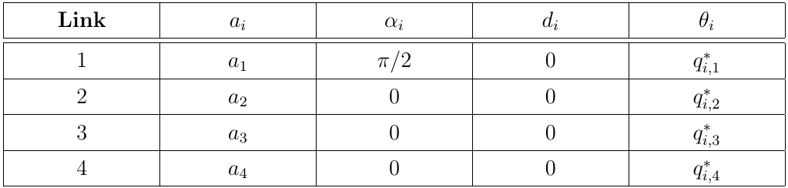
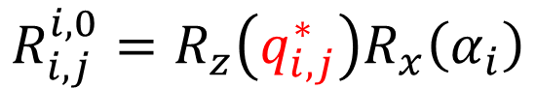
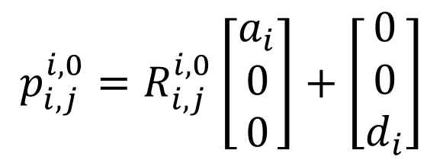
Position Kinematics: DH-Parameters
$$R_{i,j}^{i,0}=R_{z}\left(q_{i,j}^{∗}\right)R_{x}\left(α_{i}\right)$$
$$p_{i,j}^{i,0}=R_{i,j}^{i,0}\left[\begin{aligned}a_{i} \\ 0 \\ 0\end{aligned}\right]+\left[\begin{aligned}0 \\ 0 \\ d_{i}\end{aligned}\right]$$

Slide 35
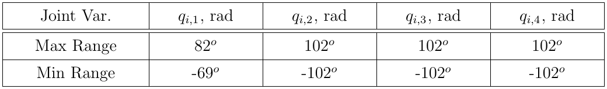
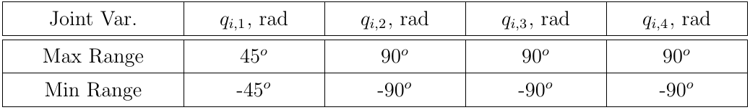
Joint Position Limits
Joint position limits (hardware-constrained)
Joint position limits (software-imposed)

Slide 36
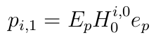
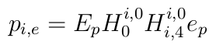
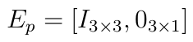
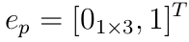
Position Kinematics: Joint/Foot Positions
Position of the first joint of the $i^{th}$ leg in $O_{0}$.
Position of each $j^{th}$ joint of the $i^{th}$ leg in $O_{0}$.
Position of each foot of the $i^{th}$ leg in $O_{0}$.

Slide 37
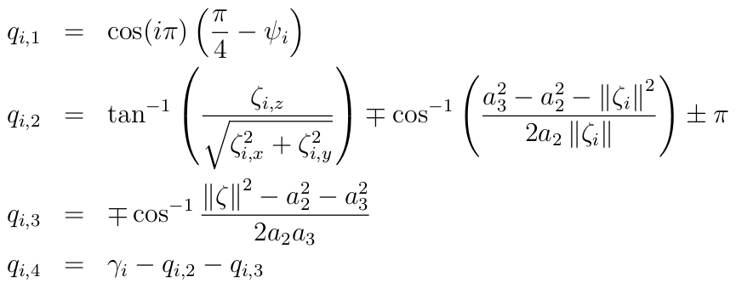
Inverse Position Kinematics (IK)
Joint configuration solution for the $i^{th}$ leg, given $p_{i,e }$and $γ_{i}$:

Slide 38
Inverse Position Kinematics (IK)
Joint configuration solution for the $i^{th}$ leg, given $p_{i,e }$and $γ_{i}$:
Ankle configuration

Slide 39
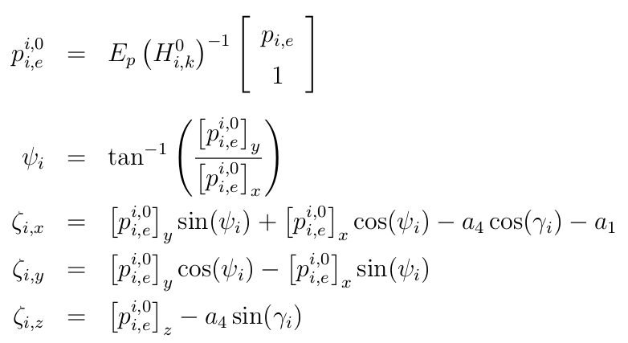
Inverse Position Kinematics, cont.

Slide 40
Inverse Position Kinematics, cont.
Foot position in local frame
Foot position configuration

Slide 41
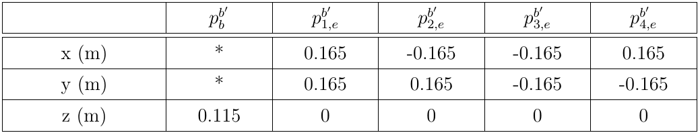
Limits on Body Posing
Kinematic feasibility of each pose is checked using the inverse kinematic solution.
Default robot stance when upright

Slide 42
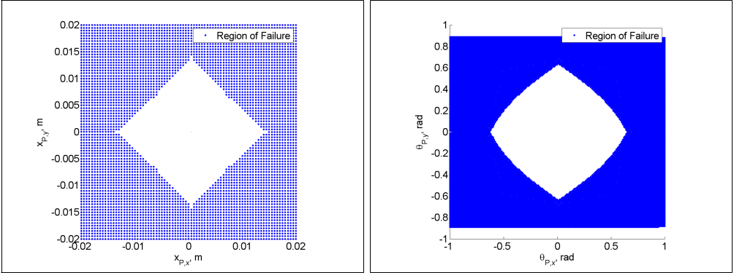
Limits on Body Posing, cont.
Trunk position (x,y)
Orientation (roll and pitch)

Slide 43
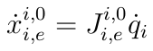
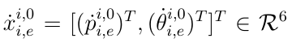
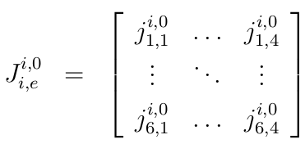
Velocity Kinematics : Manipulator Jacobian
A mapping for foot velocity in each $i^{th}$ local leg frame defined by:
Manipulator Jacobian for the $i^{th}$ leg, given $p_{i,e }$and $γ_{i}$:

Slide 44
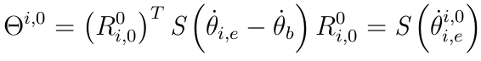
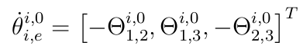
Velocity Kinematics : World Frame Tranformations
Given a body and foot velocities in $O_{0}$:

Slide 45
Velocity Kinematics : World Frame Tranformations
Given a body and foot velocities in $O_{0}$:
Angular rate of foot
Angular rate of body
Foot translational velocity
Trunk translational velocity

Slide 46
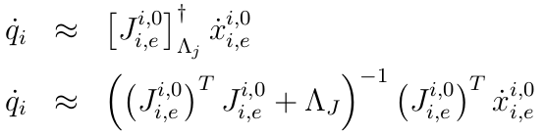
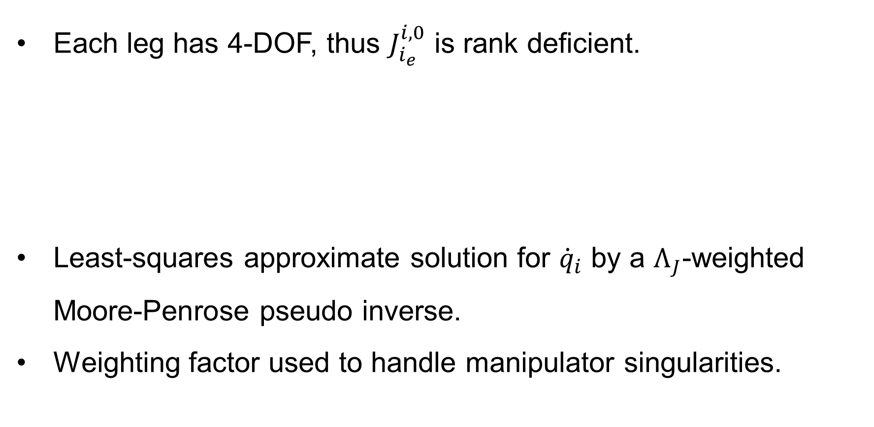
Inverse Velocity Kinematics
Each leg has 4-DOF, thus $J_{i_{e}}^{i,0}$ is rank deficient.
Least-squares approximate solution for ${\dot{q}}_{i}$ by a $Λ_{J}$-weighted Moore-Penrose pseudo inverse.
Weighting factor used to handle manipulator singularities.

Slide 47
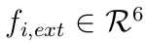
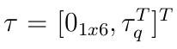
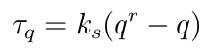
Dynamical Model
Dynamics of the system takes the following form:
with external contact-forces:
and joint input torque dynamics:

Slide 48
Dynamical Model
Dynamics of the system takes the following form:
Lump disturbance term
with external contact-forces:
and joint input torque dynamics:

Slide 49
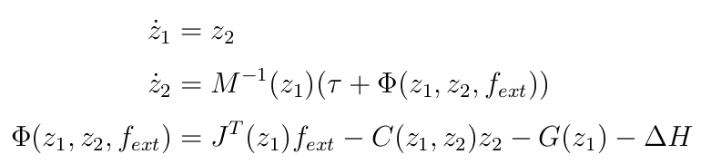
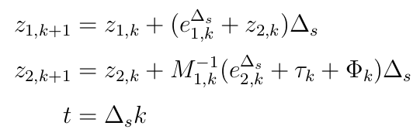


Dynamical Model : State Space Representation
First-order discretization with a sampling period $Δ_{s}$:

Slide 50

BlueFoot Simulator

Slide 51
BlueFoot Simulator, cont.
Full quadruped dynamic requires an analysis of many dynamical modes for each foot contact configuration.
Actual contact dynamics (friction, multiple collisions) can be complex
A numerical dynamical simulator helps reduce complexity
Configurable environments

Slide 52

BlueFoot Simulator, cont.
Implemented using the Open Dynamics Engine C++ library
Generates dynamical updates for all bodies via constrained quadratic minimization
Rigid body and contact dynamics formulated as a Linear Complimentary problem (LCP)
First-order integration with small time-step ($Δt≪1$)

Slide 53


Slide 54
Gaiting and Stabilization

Slide 55
Central Pattern Generator (CPG)-based Gaiting

Slide 56


CPG with Hopf Unit Oscillators
Each $i^{th}$ Hopf oscillator has a state-pair
which make up the CPG network state vectors $y_{1} ,y_{2}∈R^{4}$ by:

Slide 57


CPG with Hopf Unit Oscillators, cont.
The full Hopf-oscillator network dynamics are then
with

Slide 58
CPG with Hopf Unit Oscillators, cont.
The full Hopf-oscillator network dynamics are then
Amplitude
Frequency
Amplitude Modulation Matrix
Frequency Modulation Matrix
Coupling Matrix
with

Slide 59


CPG Network Frequency Matrix
Frequency matrix is adjusted as a function of network outputs, as done by Vitor Matos, et al:
Base frequency adjusted according to command velocities by:

Slide 60

CPG Network Frequency Matrix
Frequency matrix is adjusted as a function of network outputs, as done by Vitor Matos, et al:
Base Frequency
Duty Factor: $\left[0,1\right]$
Base frequency adjusted according to command velocities by:

Slide 61



CPG “Reflex” Design
Reflexes designed using modulation parameters:
$i^{th}$ leg reflexes using inertial feedback:

Slide 62
CPG “Reflex” Design
Reflexes designed using modulation parameters:
$i^{th}$ leg reflexes using inertial feedback:
Sigmoid Activation

Slide 63


Oscillator Coupling Design
Coupling matrix is tuned to produce different phase offsets between oscillators:
Produces 4-Pace Walking Gait
Produces 2-Pace Trotting Gait

Slide 64

Reflexive CPG Outputs during Trotting Gait

Slide 65

Reflexive CPG Outputs during Walking Gait

Slide 66

Reflexive CPG Output during Gait Transition

Slide 67

Foothold Controller

Slide 68





Foothold Controller, cont.
Reference velocity of each foot is defined by:
with

Slide 69
Foothold Controller, cont.
Reference velocity of each foot is defined by:
with
Translation Control
Height Control
Viscous Friction
Attraction Force
Reaction Force

Slide 70


Foothold Controller, cont.
Moving anchor-points for each $i^{th}$ foot and center point, $p_{c}$, are defined with the following dynamics:

Slide 71
Foothold Controller, cont.
Moving anchor-points for each $i^{th}$ foot and center point, $p_{c}$, are defined with the following dynamics:
Commanded angular rate
Command direction
Command velocity

Slide 72
ZMP Body-Placement Controller

Slide 73


ZMP Body-Placement Controller, cont.

Slide 74


ZMP Body-Placement Controller, cont.

Slide 75



ZMP Body-Placement Controller, cont.

Slide 76

ZMP Body-Placement Controller, cont.

Slide 77

ZMP Body-Placement Controller, cont.

Slide 78


NARX-NN Trunk Leveling Controller

Slide 79




NARX-NN Training Regimen

Slide 80


NARX-NN Training Regimen, cont.

Slide 81




NARX-NN Control Law

Slide 82


NARX-NN Control Law

Slide 83


NARX-NN Control Law : Results
$$v^{r}=0. 60\frac{mm}{s}$$
$$α=0.125$$

Slide 84


NARX-NN Control Law : Results
$$v^{r}=0. 60\frac{mm}{s}$$
$$α=0.250$$

Slide 85


NARX-NN Control Law : Results
$$v^{r}=0. 60\frac{mm}{s}$$
$$α=0.350$$

Slide 86
Navigation Control

Slide 87


Potential Fields

Slide 88

Potential Fields

Slide 89


Potential Fields

Slide 90


Slide 91


Slide 92


Slide 93


Potential Fields

Slide 94


Slide 95



3D Point Cloud from 2D LIDAR Scans

Slide 96
3D Point Cloud from 2D LIDAR Scans

Slide 97


3D Point Cloud from 2D LIDAR Scans, cont.

Slide 98

Height-map generation from Point Cloud

Slide 99

Height-map generation from Point Cloud

Slide 100





Cost Assignment from Height-map

Slide 101





Cost Assignment from Height-map, cont.

Slide 102


Cost Assignment from Height-map, cont.

Slide 103

Cost Assignment from Height-map, cont.

Slide 104


Sliding Window Path Planning

Slide 105


Sliding Window Path Planning, cont.

Slide 106


Sliding Window Path Planning, cont.

Slide 107
Surface Estimation

Slide 108

Source Point Cloud (1)

Slide 109

Surface Normal Estimation (2)

Slide 110

Source Point Cloud (2)

Slide 111

Surface Normal Estimation (2)

Slide 112
Concluding Remarks

